Slide 1


WP3 – Data Catalogue Services
Tobias Richter
PaNOSC General Assembly, November 2019 Trieste, Italy
This project has received funding from the European Union’s Horizon 2020 research and innovation programme under grant agreement No. 823852

Slide 2
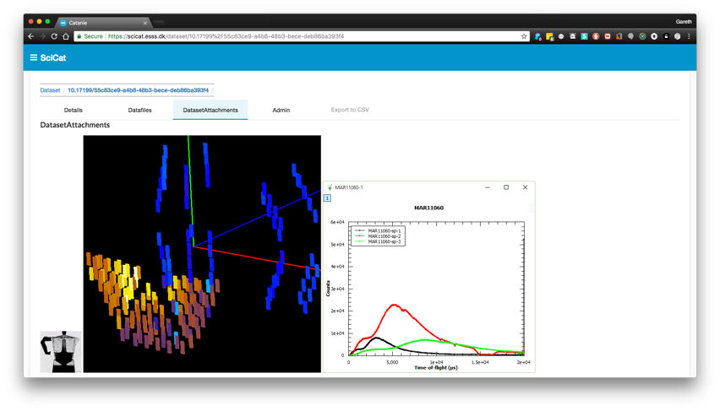



WP3 Data Catalogues – Basic Functions
Store reference to raw data and enough metadata to identify the “right” dataset to work with
Proposal Information
Sample Information
Scientific Metadata
Previews
Provenance
Relationship to other data
(derived data)
Relationship to people
Facilitate Sharing and Publication

Slide 3
Partner | CERIC | ESS | ELI | ESRF | ILL | XFEL
Catalogue | VUO online storage NOT a catalogue | SciCat | TBD | ICAT | ILL Own | myMdC
URL | https://vuo.elettra.trieste.it | https://scicat.esss.se | --- | https://datahub.esrf.fr | https://data.ill.eu | https://in.xfel.eu/metadata
Login required | Yes | Yes | --- | Yes | Yes | Yes
File formats | NeXus, HDF5, ASCII and many others | NeXus | --- | EDF, SPEC, MCA, CBF, CCD, MCCD, HDF5, NeXus | NeXus and ILL ASCII | HDF5
Database | Oracle | MongoDB | --- | Oracle and MongoDB | Oracle | MySQL and PostgreSQL
Language | Plsql, Python | Javascript | --- | JAVA and Javascript | PHP | App: Ruby(onRails), Client: Python
Main technologies | WebDAV, Guacamole | Angular | --- | React, NodeJS, EJB, JPA | Symfony, JQuery | Rails
Number of public datasets/files | 0/0 | 181/250,000 | --- | ~540K/157M | ~250K/4M | 0/0
Using OAI-PMH | No | Almost | --- | No | No | No
Minting DOIs | Yes | Yes | --- | Yes | Yes | Yes
Data/embargo policy | Not defined | Embargoed for 3 years | --- | Embargoed for 3 years, ESRF Data Policy | Embargoed for 3 to 5 years, ILL Data Policy | Embargoed for 3 with possible extension to 5 years, XFEL Data Policy
Number of instruments connected to data catalogue | None | 1 | --- | 17 | 54 | 16

Slide 4
PaNOSC Objectives
Participate in the construction of the EOSC by linking with the e-infrastructures and other ESFRI clusters.
Make scientific data produced at Europe’s major Photon and Neutron sources fully compatible with the FAIR principles.
Generalise the adoption of open data policies, standard metadata and data stewardship from 15 photon and neutron RIs and physics institutes across Europe.
Provide innovative data services to the users of these facilities locally and the scientific community at large via the EOSC.
Increase the impact of RIs by ensuring data from user experiments can be used beyond the initial scope.
Share the outcomes with the national RIs who are observers in the proposal and the community at large to promote the adoption of FAIR data principles, data stewardship and the EOSC.

Slide 5
Overview of Tasks
Different Phases of integrating data catalogues with EOSC
Task 3.1 – Develop API
Task 3.2 – Provisioning of federated Search
Task 3.3 – Local Deployment at Partners
Integration of data sources (beamline) to catalogues
Task 3.4
Determining the semantics of the search by learning from and extending NeXus
Task 3.5

Slide 6
Task 3.1: Develop API
Lead partner | ESS
Partners | ILL, XFEL, ELI, ESRF, CERIC
Months | 1-18
PMs | 59
Milestones and Deliverables | M12, D18,
Define an API to be used in the Photon and Neutron community that will allow for FAIR exposure of the data at the individual institutions through a catalogue service. The API will allow federation, and exposure of metadata relevant for the area, in a way that will enable search and facilitate access of researchers across scientific disciplines. The API will enable domain specific search extensions aware of the metadata definitions and usage at photon and neutron facilities.

Slide 7
Task 3.2: Provisioning Federated Search
Lead partner | ELI
Partners | ILL, XFEL, ESS, ESRF,CERIC
Months | 8-20
PMs | 39
Milestones and Deliverables | I12
This task will link the PaNOSC beneficiaries’ data catalogues to the EOSC hub. The EOSC hub will provide the API needed to share and search metadata. In the absence of a definition following the OpenAIRE DOI equivalent scheme should yield sufficiently wide exposure. A web service demonstrator will be provided that allows searching all PaNOSC partner sites for available datasets using the common metadata API. The demonstrator will showcase how access to the catalogue will provide identifiers that will allow the found data to be accessed and used for analysis.

Slide 8
Task 3.3: Local Deployment
Lead partner | ESS
Partners | ILL, XFEL, ELI, ESRF, CERIC
Months | 20-44
PMs | 36
Milestones and Deliverables | I24, D28, I36, D40, D44
The participants will implement the mandatory part of the API for their local data repository. This includes effort required to ensure that all facilities metadata is compliant with the standards from WP2. The implementation is expected to happen through extending the existing catalogue services at the partner sites with the API or by an equivalent solution.

Slide 9
EOSC Exposure Options
In an ideal case data would be available selectively to the appropriate user (third party or original PI) with a relevant set of metadata.
For PaN experts and especially the PI during the embargo period we need a custom search API with (potential) authentication.
Large exposure of datasets can be achieved immediately by opening data publicly to harvesting by third-party repositories with minimal metadata.
Ideal
Domain Specific Search
NeXus
wealth of PaN specific metadata
EOSC Harvesting
Dublin Core DataCite
size of audience

Slide 10

EOSC Harvesting API
Immediate and wide exposure
Low effort to implement
Options:
OAI-PMH
ResourceSync
JSON-LD/Schema.org
Registration with re3data is ongoing by partners (gets us into OpenAIRE)
Much interest from B2FIND (EUDAT).
Straightforward mapping to current generic third-party metadata schemas
Granularity of data exposed will be coarse and metadata will not be very domain specific
However: Third party repositories are open to discuss potential metadata extensions

Slide 11
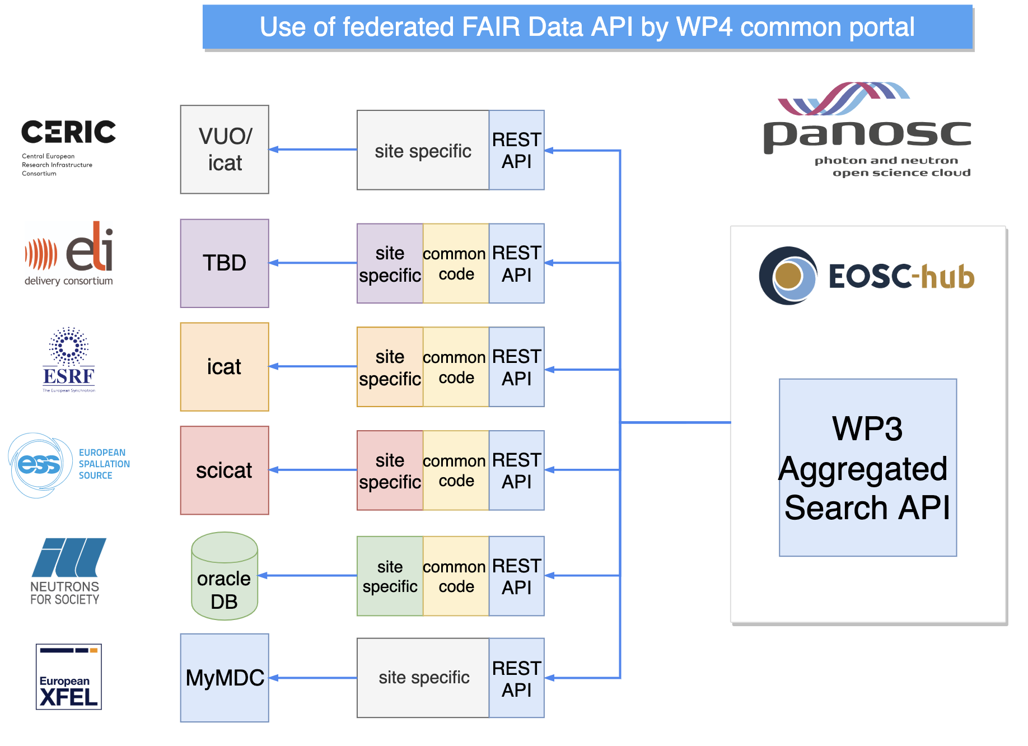
PaNOSC Federated Search API
PaNOSC (and ExPaNDS) specific API with all the domain specific benefits that make the metadata handling attractive to PIs:
Optional authentication enables handling of embargoed data (WP4)
Granularity can be customised as appropriate
All relevant metadata can be searched
Use cases and documentation exists, prototype in progress.
Federation not maintained long term (calls for EOSC adoption).

Slide 12
Task 3.4: Catalogue Integration
Lead partner | ELI
Partners | ILL, XFEL, ESRF, CERIC
Months | 12-48
PMs | 88
Milestones and Deliverables | M12, I17, M30,
Integration of data production facilities with the data catalog which is especially important for heterogeneous and distributed facilities. This task will document best practices and support heterogenous and distributed facilities getting their workflow to support cataloging data.

Slide 13
Capturing Experimental Metadata
Users are not much incentivised to disclose all metadata openly to third parties. They will only add what they find it useful for their own purposes.
Users keep metadata in
Filenames (run1_vanadium_15V.csv)
Excel spreadsheets
Google docs / Evernote
Jupyter Notebooks
Paper logbook
Entering metadata in the catalogue needs to be easy and add value.
As much as possible capturing metadata needs to be automated.

Slide 14
Task 3.5: Meta Ontology for Catalogues
Lead partner | ESS
Partners | ILL, XFEL, ELI, ESRF, CERIC
Months | 1-42
PMs | 69
Milestones and Deliverables | I17, I24, I33, D42
Extend NeXus metadata standards to enhance interoperability. For large parts of the PaN communities NeXus is the most commonly used file format. To explore relevant foreign datasets in the public domain, searches on the scientific metadata need to yield the correct results. Building search terms and keywords from the NeXus dictionary, would make use of the community buy in and expertise that went into this standard.
In this task we can add missing raw data definitions for raw data, as well as some for processed derived data. Working towards an Ontology will help harmonize processing codes between facilities.

Slide 15

NeXus Dissemination
NeXus is the common data format of choice in PaNOSC and beyond.
ELI has joined the NeXus advisory committee – 50% of facilities now represented.
The WP ran a series of “Show & Tell” sessions to share the common practises at the partners with respect to storing data and metadata in NeXus. This was a valuable exercise to show that no perfect NeXus files exist and a pragmatic approach to encoding and extracting is acceptable.
For the search there is no need to unlock the entire wealth of information that can the transcribed in a NeXus file. A limited set of less than twenty key facts would go a long way. A list of techniques used at PaN facilities is being compiled first. More Ontology work follows in upcoming meetings with ExPaNDS.

Slide 16
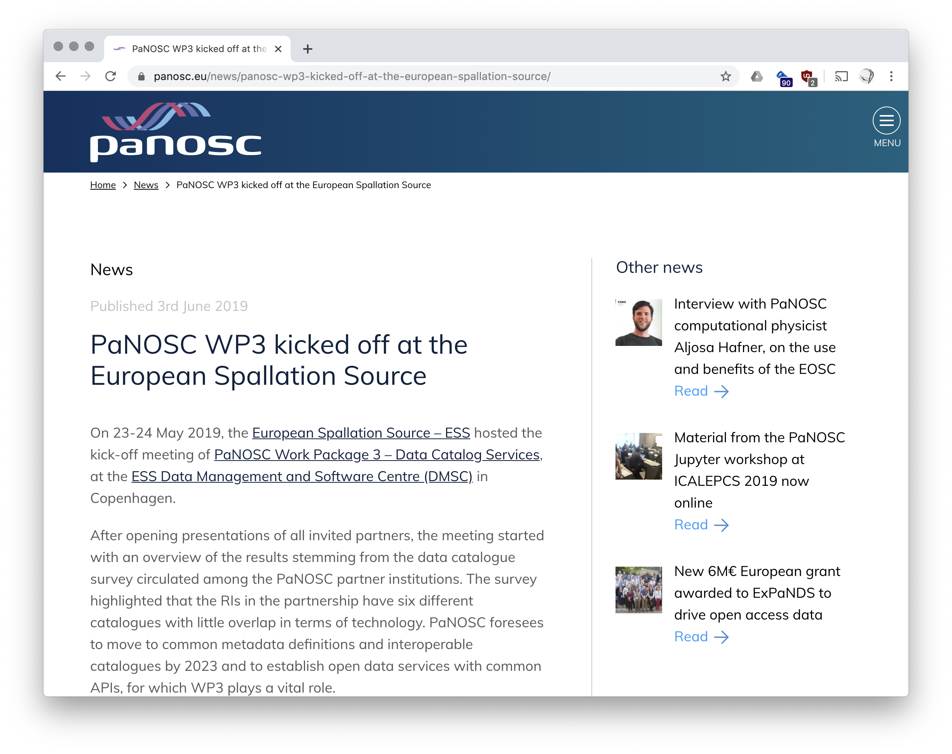
Activities, Organisation and Status
Meetings in Year One:
PaNOSC kick off Grenoble - January
WP3 Kick off Copenhagen - May
WP3 Meeting Grenoble - September
WP3 Meeting Trieste - November
VC: Monthly Meetings – Coordination
VC: Topical Meetings on API
VC: NeXus Show & Tell Sessions with all partners
Collaboration Tools
Github https://github.com/panosc-eu/fair-data-api https://github.com/panosc-eu/common-api
Confluence https://confluence.panosc.eu/display/wp3/

Slide 17
Contact with other communities – RDA
Sample information
https://www.rd-alliance.org/designing-pathway-towards-implementing-transdisciplinary-data-infrastructure-physical-samples
Different communities have found different sets of sample metadata with little to no overlap.
Metadata for research data
https://www.rd-alliance.org/research-metadata-schemas-wg
Discussions around a schema.org based JSON-LD web scraping solution. Similar to what we looked at. Would be easy to adopt in the WP if successful.
Units
https://www.rd-alliance.org/digital-representation-units-measure-drum-%E2%80%93-technical-discussion
Complication around every corner with domain or technique specific conventions.

Slide 18
Effort and Spent Profile
A start-up and recruitment phase was built into the proposal. With that in mind, overall we are tracking exactly the profile with the actual reporting towards the project.
There are some deviations between partners, that should be resolvable.
The bigger tasks are about to start: implementation at partners and catalogue integration. Year two is going to be the busiest of the project.

Slide 19
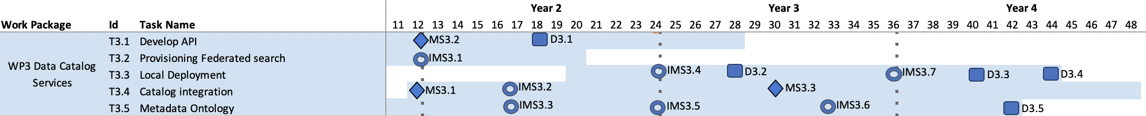
Milestones and Outlook
Three milestones to be completed before the end of the month. Workshop after the GA will be used to finalise .
Remaining duration of the project is appropriately peppered with milestones (internal and official) and deliverables to have a continuous progress indicators.
Alignment with ExPaNDS provides additional oversight and checkpoints.

Slide 20
Conclusion
Goals and target solutions have been identified, roadmap established.
Good ramp up phase of the project nearing a successful completion:
Harvesting solution to immediate data exposure close can be evaluated. Progress on custom metadata schemas is being made. Contacts with EOSC providers established.
Design of custom search API is going well and runs on schedule.
NeXus dissemination activities have been useful for partners and the WP.
Next operational year will be busiest in WP3.
Partners need to decide on their data catalogue implementations.
ExPaNDS may provide additional input with hopefully manageable distraction.

Slide 21
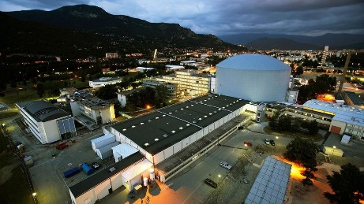
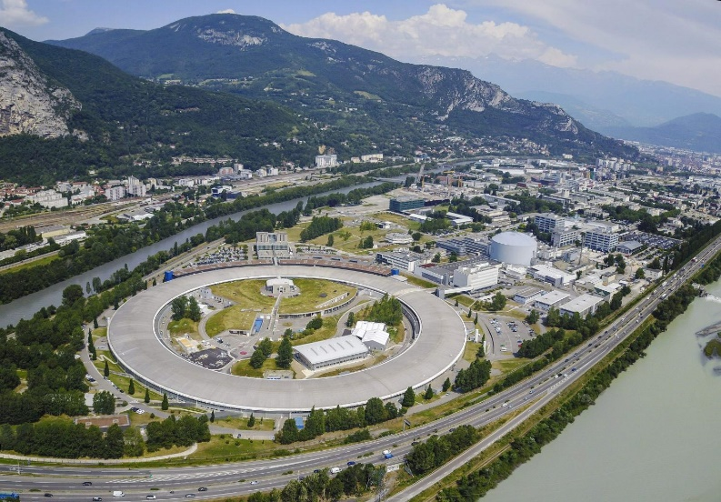
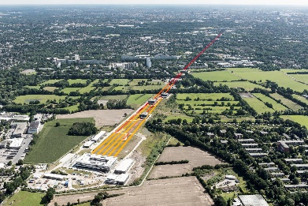





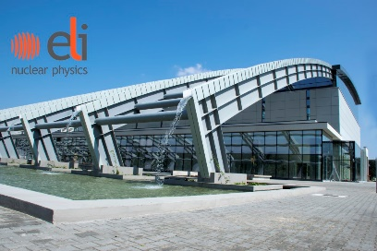




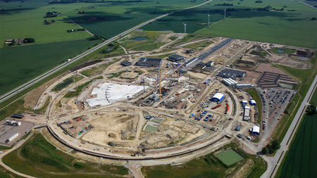

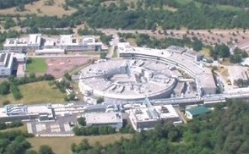


Photon and Neutron Open Science Cloud
Notes:
PEOPLE
Catalogues
Datasets
policies

